Slide 1
An introduction to
strangeness analysis and reconstruction in O2

Slide 2

The strangeness analysis workflow
Converted AO2D.root files
Converted AO2D.root files
V0 table: {positive track ID, negative track ID, collision ID}
cascade table: {positive track ID, V0 ID, collision ID}
Fulltracks, TracksExtended tables
Cross-check/special
Find: find V0s and cascade from scratch, generate analysis tables [2]
Build: Regenerate all V0 and cascade properties for analysis using cascade and V0 producer tasks [1]
Regular analysis flow
Configure cuts
Configure as filter
v0data, v0dataext, cascdata, cascdataext tables: analysis-level info
Analyse: Analyse the V0s and cascades via consumer tasks [3] (or any other analysis tasks interested!)
[1] Analysis/Tasks/PWGLF/lambdakzerobuilder.cxx, cascadebuilder.cxx
[2] Analysis/Tasks/PWGLF/lambdakzerofinder.cxx, cascadefinder.cxx
[3] Analysis/Tasks/PWGLF/lambdakzeroanalysis.cxx, cascadeanalysis.cxx

Slide 3
Candidate combinatorics
All possible candidates
All possible candidates
Reconstruction
Index pairs, triplets in AO2D
Finders
Builders
Analysis data tables
Analysis data tables
User analysis
User analysis
Actual analysis
Actual analysis
Beware: regular analysis workflow does not allow for looser selections than stored indices!
Also the case in Run 2, involves base choices
(We will make sure they’re loose enough :-) )
Replaying the finders: very heavy operation, only meant for cross-checks / benchmark for now
Remains an option for generating derived data if strictly needed, careful use

Slide 4
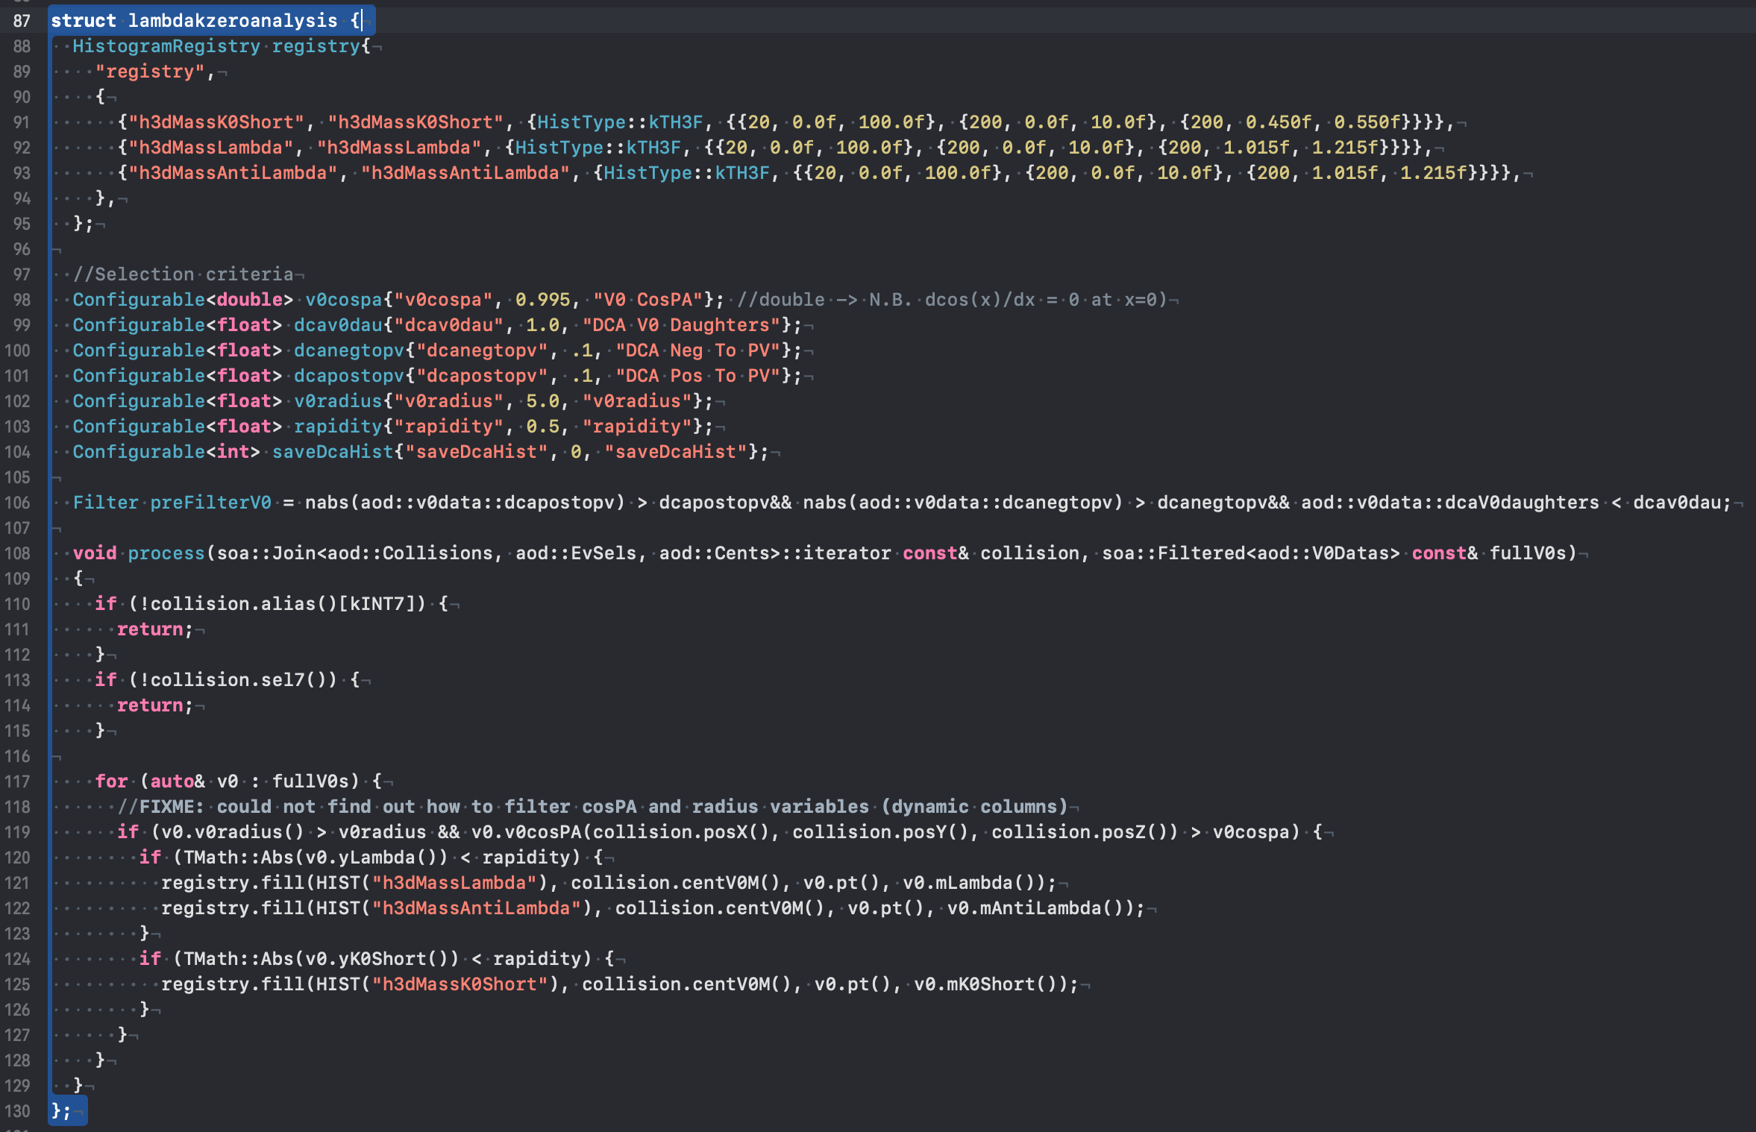
Table content: V0s
StrangenessTables.h:
v0::PosTrackID
v0::NegTrackID
v0::CollisionID
v0data::PxPos
v0data::PyPos
v0data::PzPos
v0data::PxNeg
v0data::PyNeg
v0data::PzNeg
v0data::X
v0data::Y
v0data::Z
v0data::DCAV0Daughters
v0data::DCAPosToPV
v0data::DCANegToPV
v0data::Pt(dynamic)
v0data::V0Radius (dynamic)
v0data::V0CosPA (dynamic)
v0data::DCAV0ToPV (dynamic)
v0data::MLambda (dynamic)
v0data::MAntiLambda (dynamic)
v0data::MK0Short (dynamic)
v0data::YK0Short (dynamic)
v0data::YLambda (dynamic)
v0data::Eta (dynamic)
v0dataext::Px (expression)
v0dataext::Py (expression)
v0dataext::Pz (expression)
converted
Producer: makes analysis trivial task
Consumer (typical): simple loop, subscribe only to aod::V0DataExt
Recalculated
On demand
Simple loop, all topological variables available

Slide 5
Table content: Cascades
StrangenessTables.h:
cascade::V0ID
cascade::BachelorID
cascade::CollisionID
cascdata::Charge
cascdata::PxPos
cascdata::PyPos
cascdata::PzPos
cascdata::PxNeg
cascdata::PyNeg
cascdata::PzNeg
cascdata::PxBach
cascdata::PyBach
cascdata::PzBach
cascdata::X
cascdata::Y
cascdata::Z
cascdata::Xlambda
cascdata::Ylambda
cascdata::Zlambda
cascdata::DCAV0Daughters
cascdata::DCACascDaughters
cascdata::DCAPosToPV
cascdata::DCANegToPV
cascdata::DCABachToPV
cascdata::Pt (dynamic)
cascdata::V0Radius (dynamic)
cascdata::CascRadius (dynamic)
cascdata::V0CosPA (dynamic)
cascdata::CascCosPA (dynamic)
cascdata::DCAV0ToPV (dynamic)
cascdata::DCACascToPV (dynamic)
cascdata::Mlambda (dynamic)
cascdata::Mxi (dynamic)
cascdata::Momega (dynamic)
cascdata::Yxi (dynamic)
cascdata::Yomega (dynamic)
cascdata::Eta (dynamic)
cascdataext::PxLambda (expression)
cascdataext::PyLambda (expression)
cascdataext::PzLambda (expression)
cascdataext::Px (expression)
cascdataext::Py (expression)
cascdataext::Pz (expression)
converted
Recalculated
-> same underlying principle

Slide 6
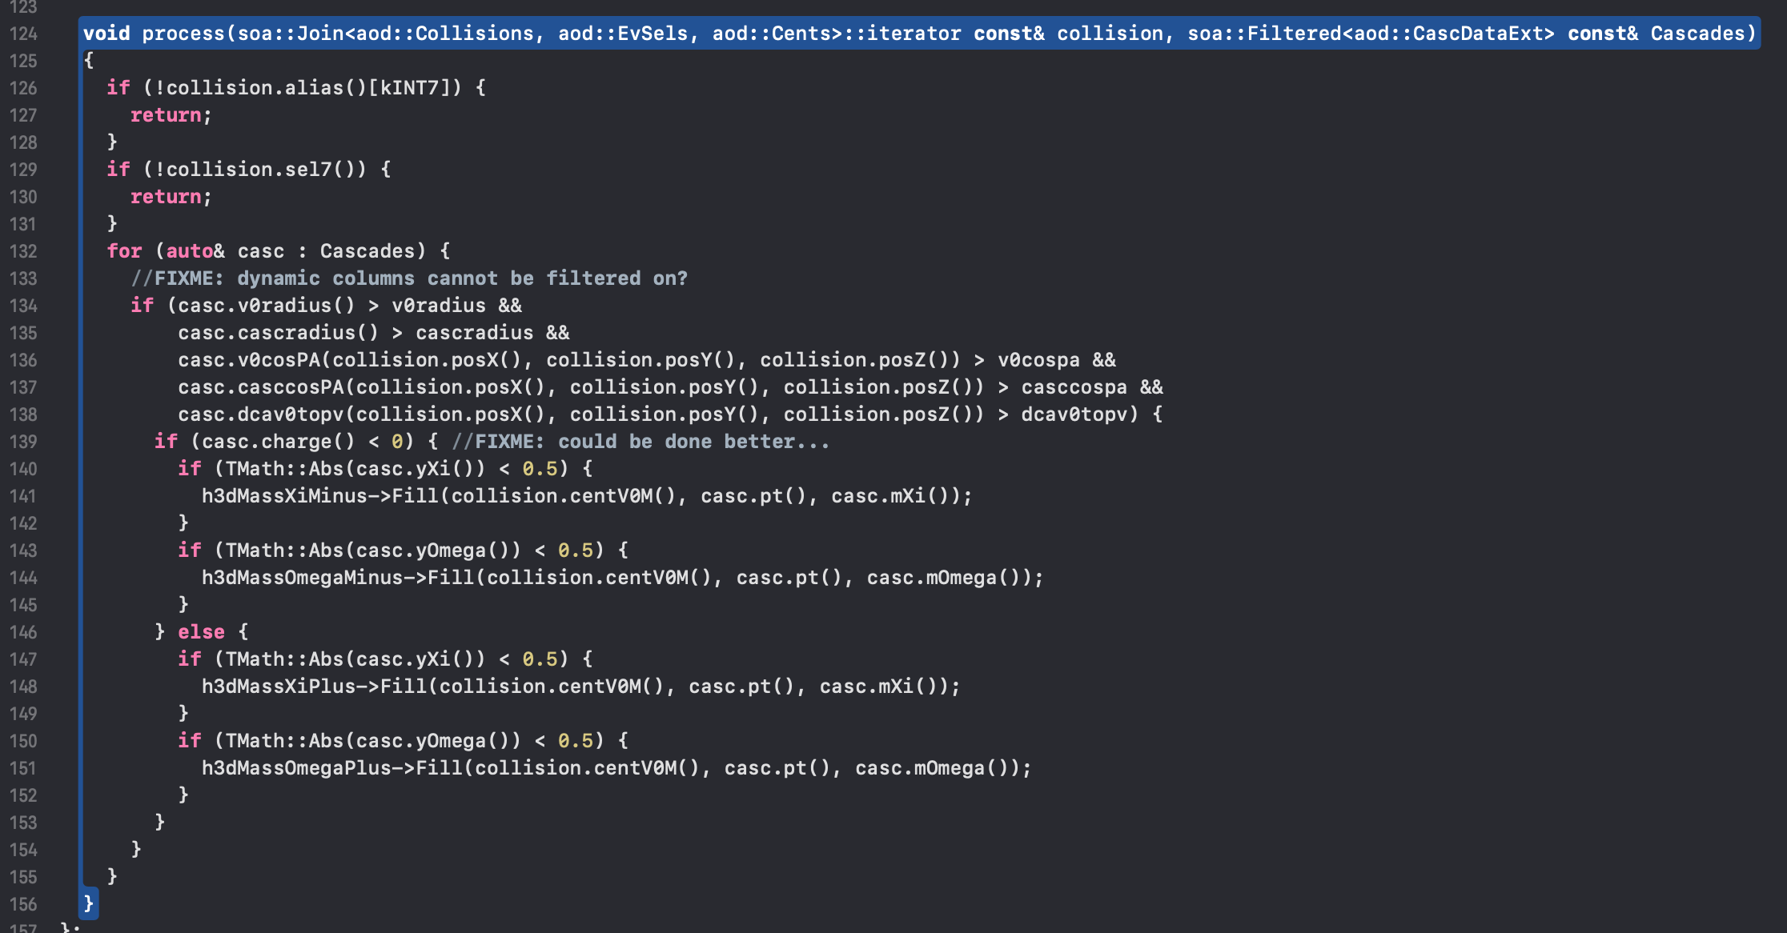
Analysis example: Cascades
(after production of cascdata, cascdataext)
Non-dynamic columns
can be filtered on
Note: some vars need PV position
Task only fills analysis histos

Slide 7
V0 finding from scratch
Analysis/Tasks/PWGLF/lambadkzerofinder.cxx
A crucial task in reconstruction, but too heavy for analysis
At this point: explore + test O2 performance (benchmark!)
Single track quality:
kTPCrefit
N_{crossed rows} > 70
DCA to PV > 0.1cm
Task: lambdakzeroprefilter
Produces<aod::v0goodpostracks> v0GoodPosTracks;
Produces<aod::v0goodnegtracks> v0GoodNegTracks;
Task: lambdakzerofinder
Produces<aod::v0data> v0data;
Task: lambdakzerofinderQA
Generates basic QA plots and 3D mass histos
V0 selection:
DCA V0 Daughters
V0 Cosine PA
V0 radius
Same structure as the V0s built with the builder -> interchangeability!

Slide 8
Cascade finding from scratch
Analysis/Tasks/PWGLF/cascadefinder.cxx
V0 quality:
DCA V0 Dau
DCA Neg, Pos to PV
V0 CosPA
DCA V0 to PV
(Anti)lambda mass
Task: cascadeprefilter
Produces<aod::cascgoodlambdas> cascGoodLambdas;
Produces<aod::cascgoodantilambdas> cascGoodAntiLambdas;
Produces<aod::cascgoodpostracks> cascGoodPosTracks;
Produces<aod::cascgoodnegtracks> cascGoodNegTracks;
Task: cascadefinder
Produces<aod::cascdata> cascdata;
Task: cascadefinderQA
Generates basic QA plots and 3D mass histos
Single track quality:
kTPCrefit
N_{crossed rows} > 70
DCA to PV > 0.1cm
Cascade selection:
DCA casc. daughters
Casc. Cosine PA
Casc. radius
Maximize pre-filtering for performance
Conceptually similar to V0 finding: previous slide applies!
Same output structure as the builder -> interchangeability!

Slide 9
Hands-on part 1
A basic V0 analysis

Slide 10
Setup: the data and the files
Now we will use a converted sample of LHC15o data and get some V0 invariant mass distributions
Download the input file:
Alternatively, use dropbox: link
We will start from an analysis skeleton for V0s. Download the task from:
  https://www.dropbox.com/s/65f5tlwh3816ot0/LFStrangeTut1.cxx?dl=0
alien_cp alien:///alice/data/2015/LHC15o/000244917/pass5_lowIR/PWGZZ/Run3_Conversion/148_20210304-0829_child_1/0017/AO2D.root AO2D_test.root

Slide 11
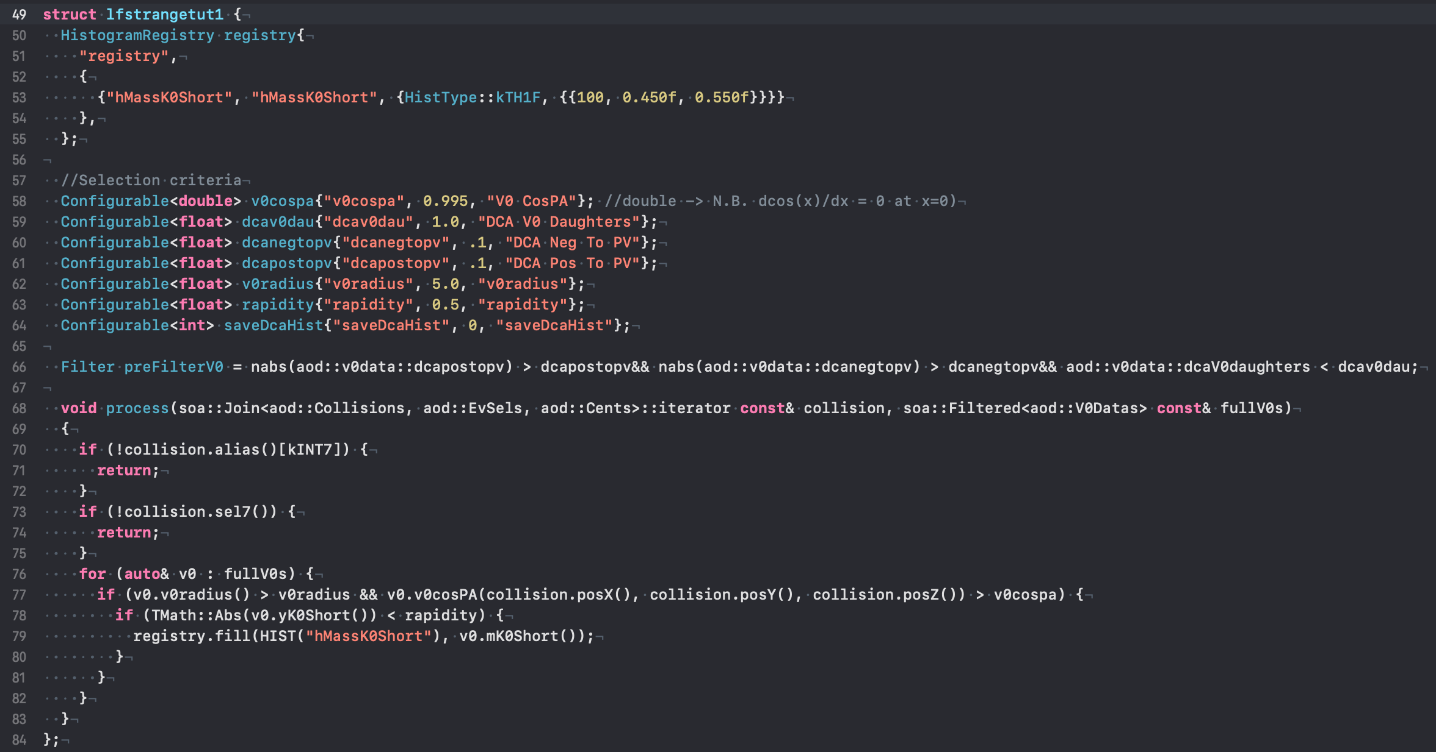
The basic strangeness analysis skeleton
Test histogram
Selection criteria
Candidate loop

Slide 12
The workflow: let’s try it out, builder
The standard analysis requires several components to be run correctly. A valid call is:
o2-analysis-timestamp --aod-file AO2D_test.root -b |
o2-analysis-multiplicity-table -b |
o2-analysis-centrality-table -b |
o2-analysis-event-selection -b |
o2-analysis-trackextension –b |
o2-analysis-weak-decay-indices -b |
o2-analysis-lambdakzerobuilder --d_bz 5 -b |
o2-analysis-LFStrangeTut1 -b
Process track indices
Build V0 information, do not forget magnetic field!
Your analysis!

Slide 13
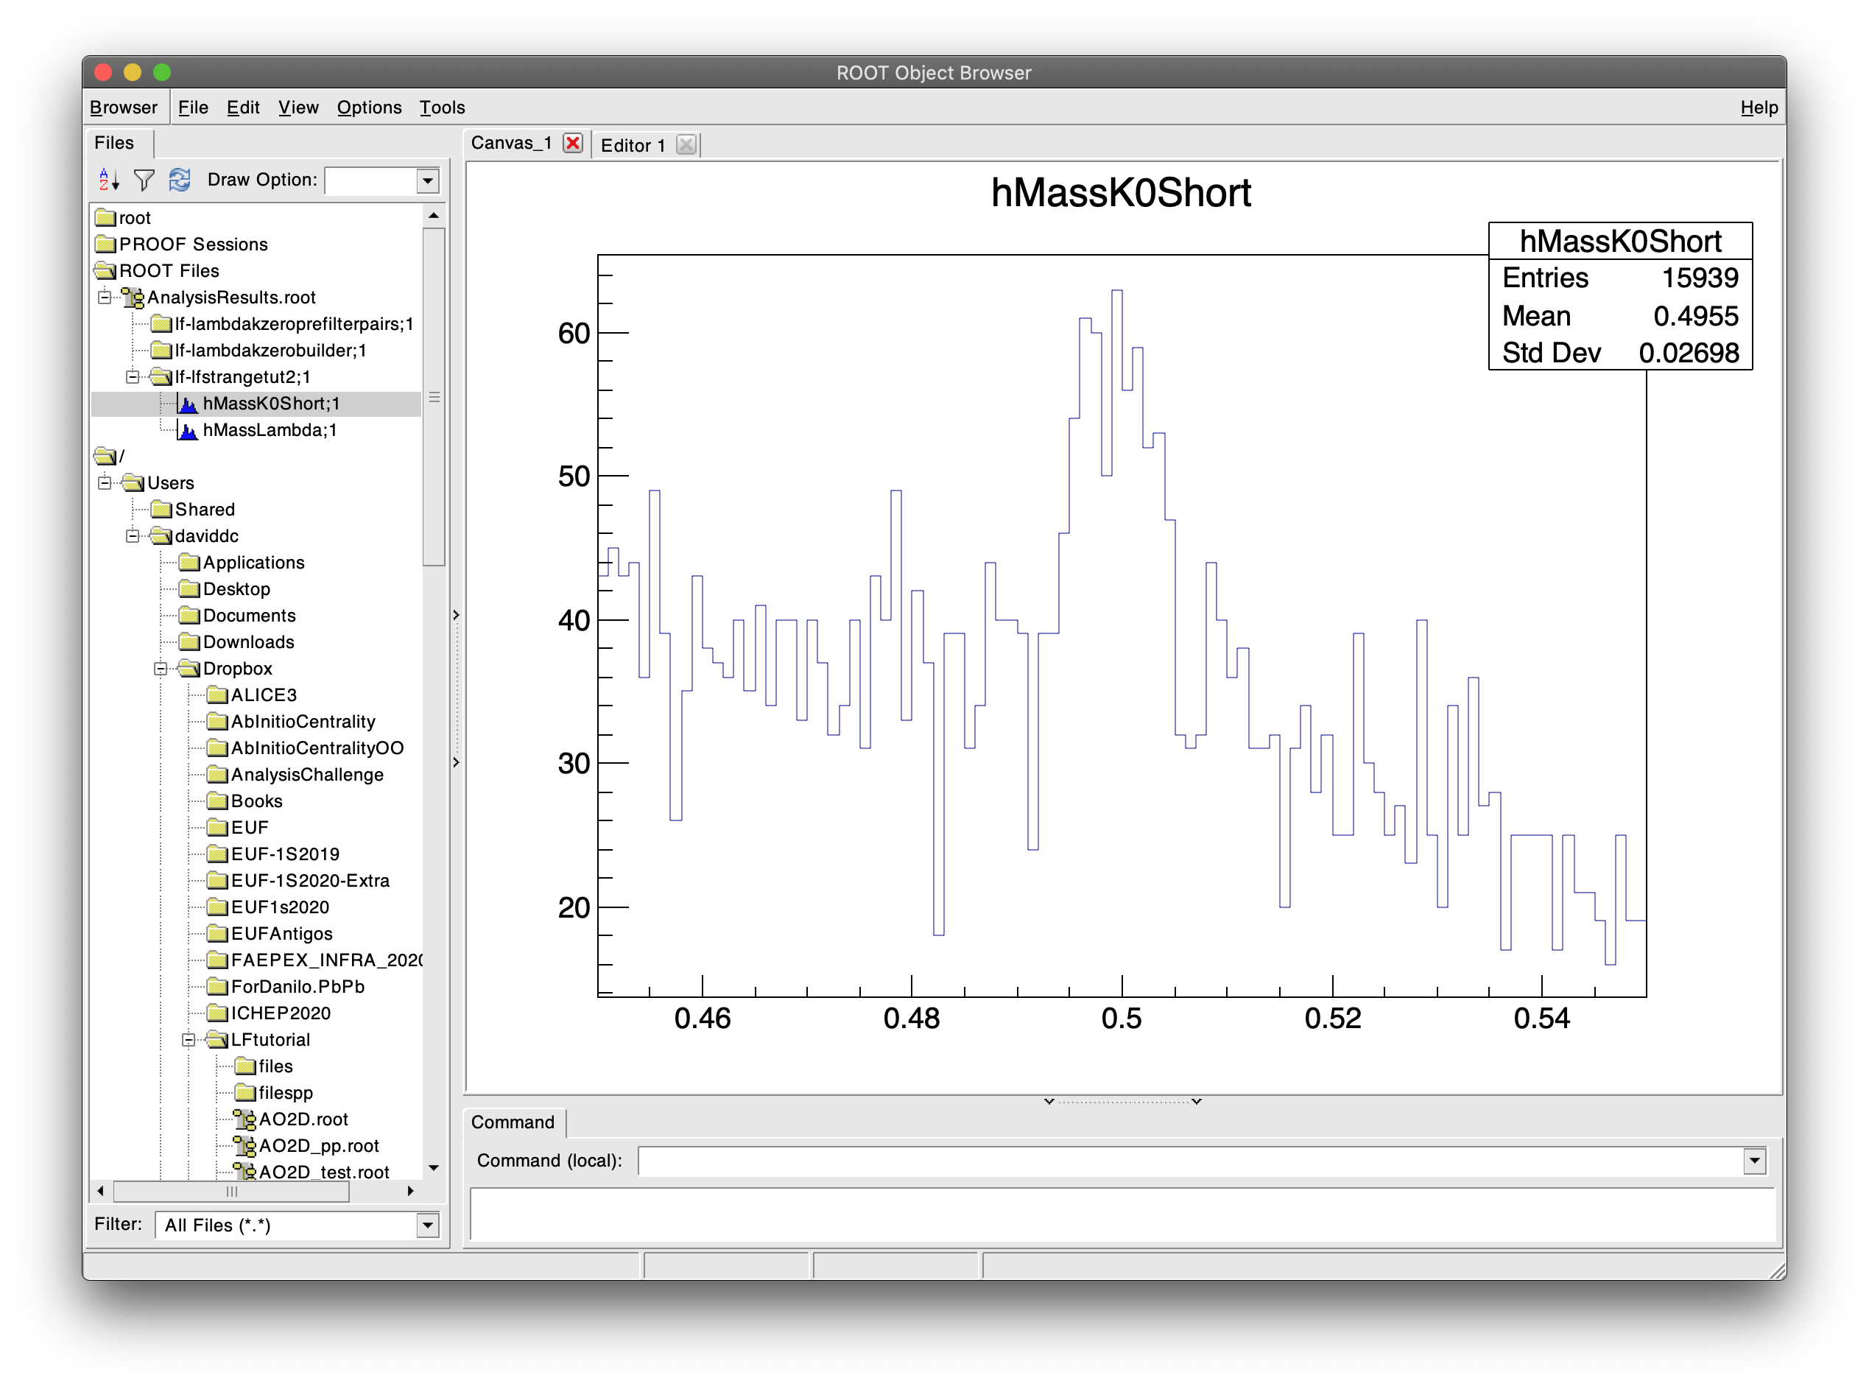
Step 1: The output
Still not much data… Let’s loop over
further AO2D files!
…and we will then slowly build up…

Slide 14
Step 2: Downloading more files
Use a bash script to download new AO2D files to run over! Here is an example: multidownload.sh
In your working directory, simply do:
[0] mkdir files
[1] source multidownload.sh
And you will download 10 files!
(No token? No certificate? In panic? Okay, check out this dropbox link and download from there)
Then, call:
[2] ls files/AO2D_*.root > l.txt
This will give you a list with all files you just downloaded. You can run on that!
But before that, let’s add a simple Λ invariant mass histogram…

Slide 15
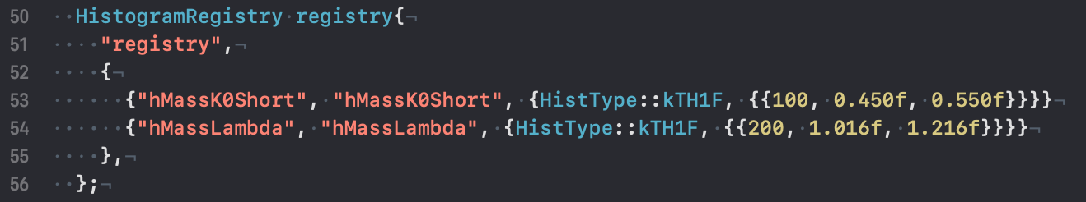
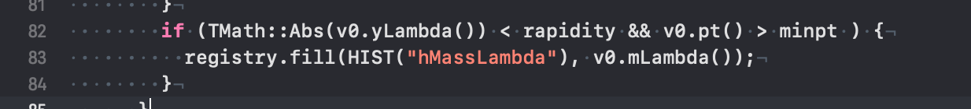
Step 2: Adding a Λ invariant mass histogram
This is a simple modification: just follow the lead of the hMassK0Short histogram!

Slide 16
Step 2: Adapting the workflow: adding selection criteria
Now we can run over several files! We can use:
o2-analysis-timestamp --aod-file @l.txt-b --shm-segment-size 16000000000 |
o2-analysis-multiplicity-table -b |
o2-analysis-centrality-table -b |
o2-analysis-event-selection -b |
o2-analysis-trackextension –b |
o2-analysis-weak-decay-indices -b |
o2-analysis-lambdakzerobuilder --d_bz 5 -b |
o2-analysis-LFStrangeTut1 -b --v0cospa 0.999
Ensure enough memory
Extra selection on V0 cosine of pointing angle

Slide 17
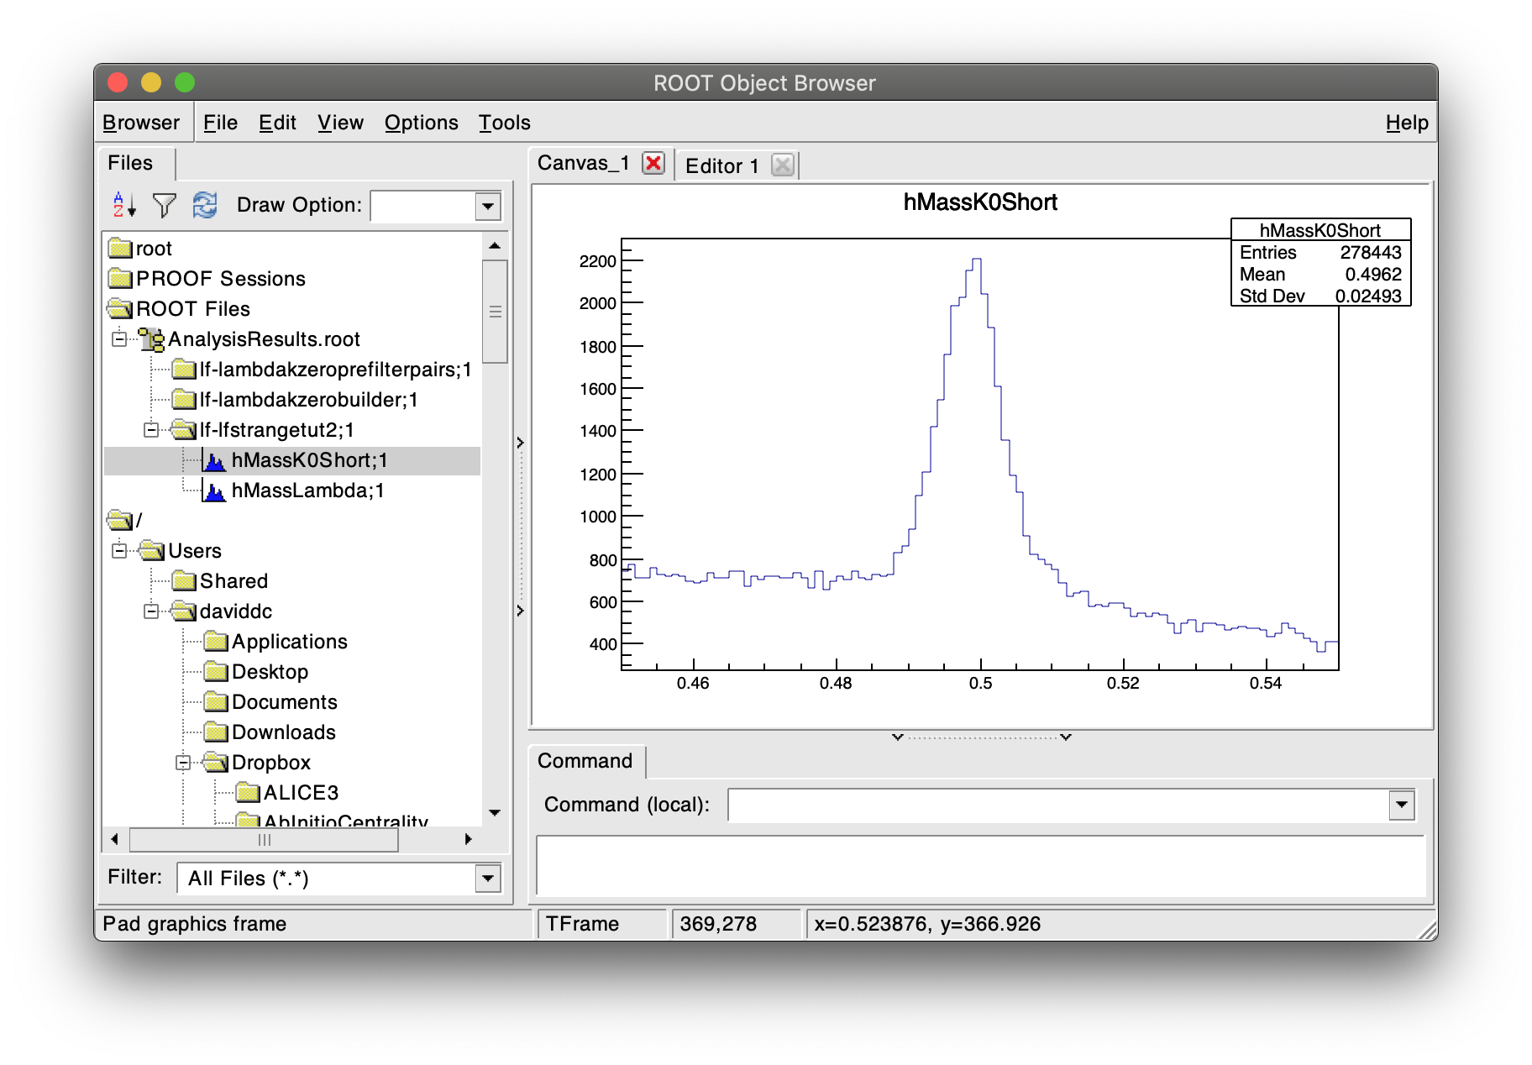
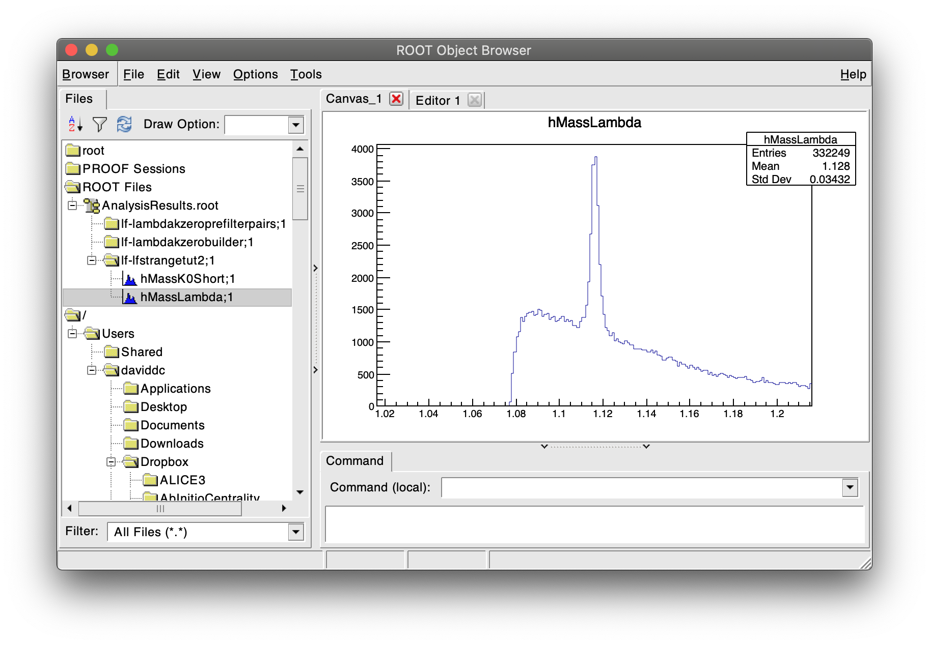
Step 2: The new output: Λ invariant mass
Still needed: TPC dE/dx!
Let’s now combine information
from the previous tutorial!
Much better!
The code after this step: https://www.dropbox.com/s/93qvpr16eeauq0e/LFStrangeTut2.cxx?dl=0

Slide 18
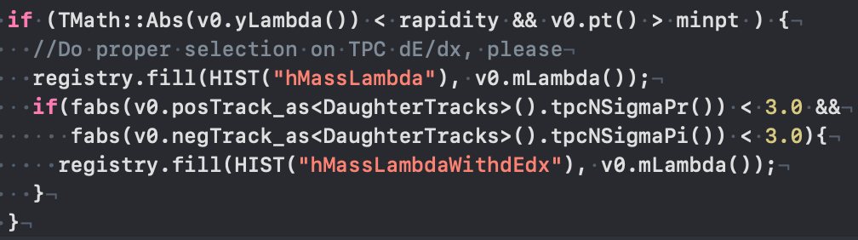
Step 3: Adding a TPC dE/dx selection on daughter tracks
Add PID response header
Add subscription to tracks with PID information
Use selection
Note: _as<>

Slide 19
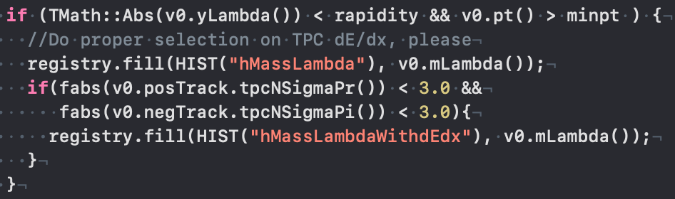
Step 3: The _as<> functionality
The v0 table references a track table that does not contain PID.
Trying to check PID information with a reference to that table will fail! It’s not a simple index
You need to de-reference the track via a _as<> call: will look at the same position in the more complete table!
Valid in any similar situation, very useful!
OK!
Crashes!

Slide 20
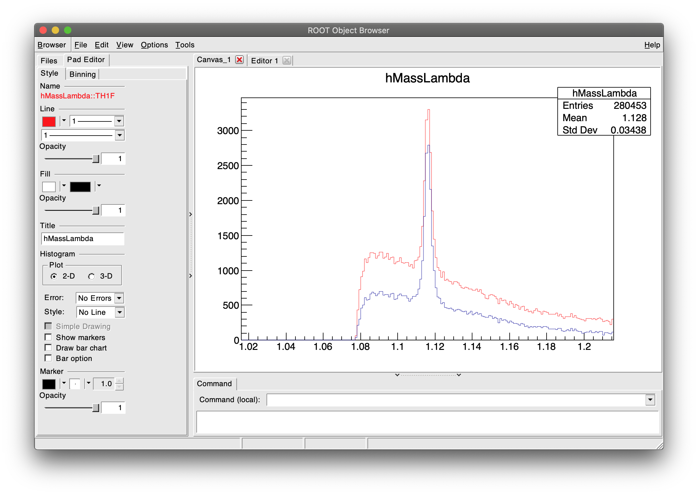
Step 3: Λ invariant mass with extra dE/dx selection
Okay, this worked! But… is the gain so small with dE/dx?

Slide 21
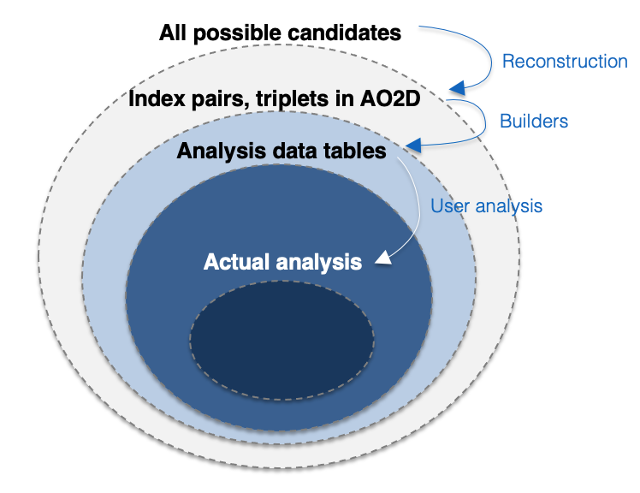
Step 3: Λ invariant mass with extra dE/dx selection
Okay, this worked! But… is the gain so small with dE/dx?
  Actually, no! Remember this:
The code after this step:
https://www.dropbox.com/s/vib3h1mngn8v9zf/LFStrangeTut3.cxx?dl=0
There’s a dE/dx pre-selection applied here!

Slide 22
Hands-on part 2 (‘bonus’)
Creating custom tables as desired

Slide 23
Step 4: An important feature: creating custom tables
Tables are the cornerstone data container in O2.
…but they are not only those we provided!
You can have your own, fully customized, skimmed / derived table!
This is useful for data reduction and optimizing your algorithm!
Here, we’ll walk you through a very basic example:
Let’s say you’re now happy with your dE/dx-selected Lambda candidates and you want to save their invariant masses for posterior analysis in a new table. It’s less data! So let’s do it…

Slide 24
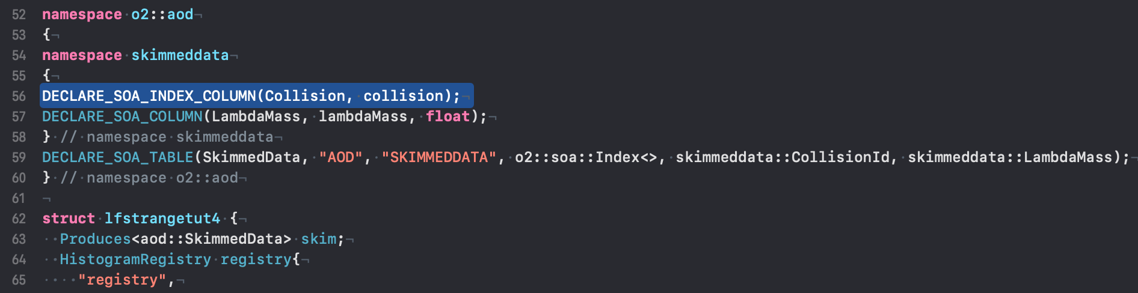
Step 4: Declaring a custom table
You can declare a custom table even inside your own task cxx file! See:
Collision index: allows for collision grouping
Your favorite information
Declaring the table
Statement to the framework: this task produces this table! Important for automatic task ordering

Slide 25
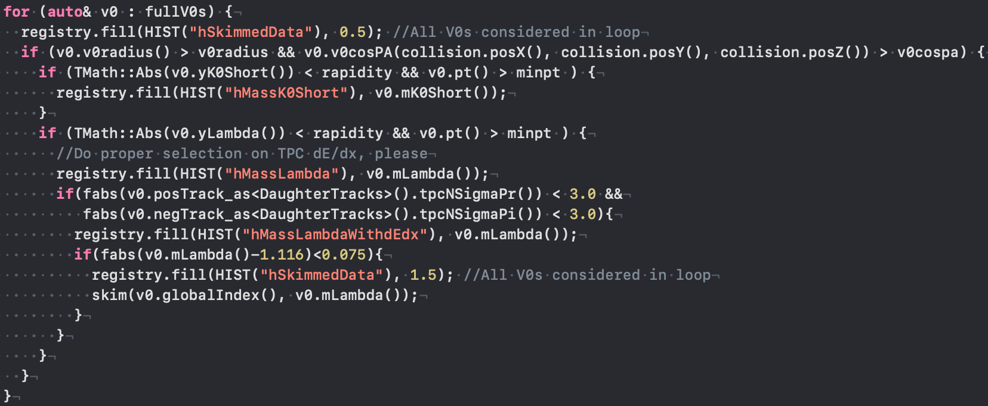
Step 4: Filling a custom table
Bookkeeping of skim fraction (for info!)
Fill the skimmed information table: provide data elements in order!

Slide 26
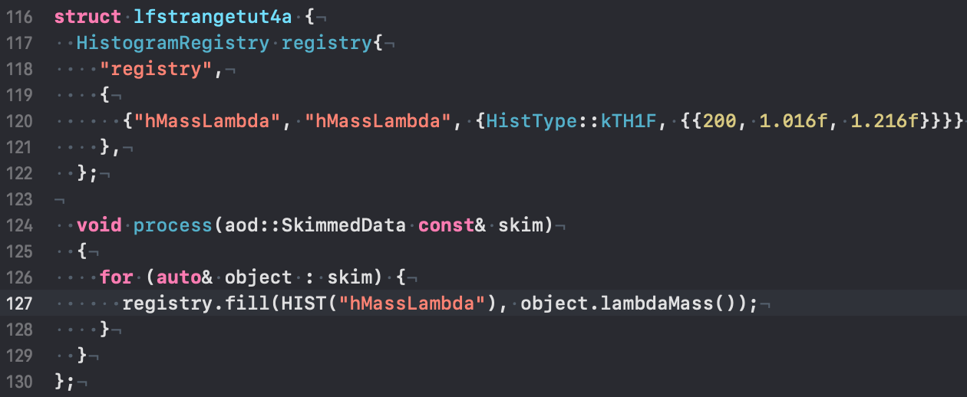
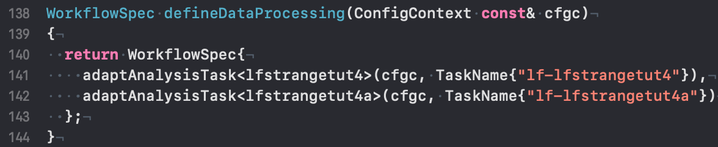
Step 4: Declaring a sub-task that uses this information
Simple and intuitive looping

Slide 27
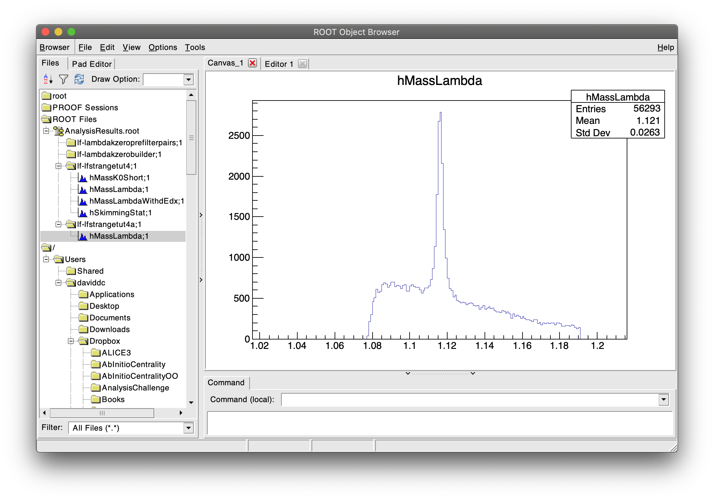
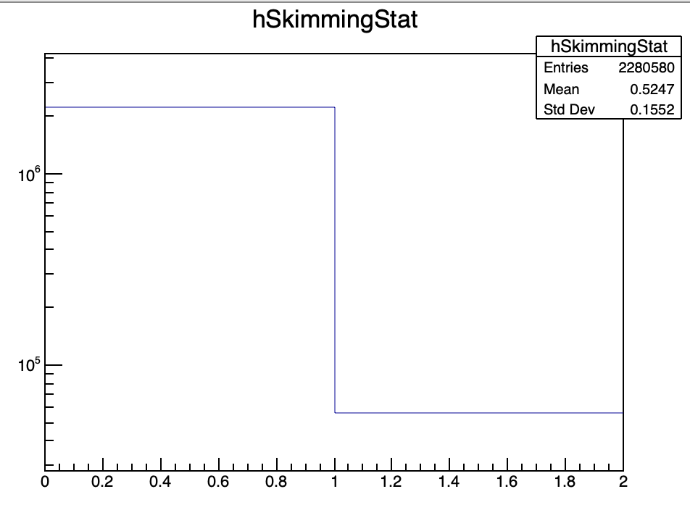
Step 4: The skimming example: results
2224K / 56K = 40x reduction!
The same analysis result!
The code after this step:
https://www.dropbox.com/s/mluv518alerks76/LFStrangeTut4.cxx?dl=0

Slide 28
Summary
Here, you saw:
  an example V0 analysis
  how to apply topological selections
  how to apply PID information
  how to construct a custom table with selected information for posterior analysis
It goes way beyond: cascades, nuclei, etc!
Thank you!

